Slide 1

Hitler’s Rise to Power
From failed artist to Führer

Slide 2
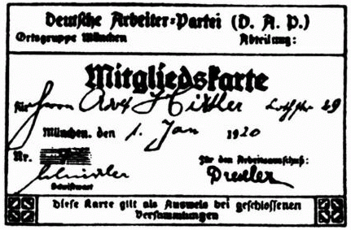
German Worker’s Party
After WWI, Hitler worked as an intelligence officer with the German Army.
As part of his job he observed a meeting of the Deutsche Arbeiterpartei
Hitler was invited to join the DAP a few days after this meeting
Hitler’s DAP membership card

Slide 3

DAP to Nazis
1920 Hitler is appointed as the head of propaganda for the DAP
20 February 1920 name is changed to Nationalsozialistische Deutsche Arbeiterpartei
NSDAP 25 point program is announced, outlining political ideology and aims
July 1921 – Hitler overthrows party founder, Anton Drexler, as leader of NSDAP
14 September 1921 Hitler arrested for beating up Otto Ballerstedt, Hitler’s most vocal opponent in NSDAP. Sentenced to 3 months jail – serves 1 month.

Slide 4

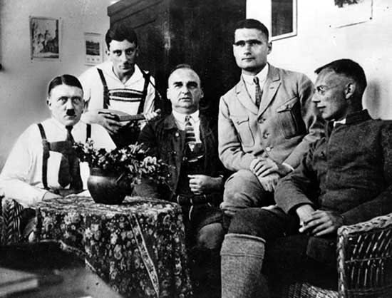
Growth of Nazi Support
Hitler forms 2 important bodies within the NSDAP:
  Jungsturm und Jugendbund – the Hitler Youth
  Schutzstaffel - The SS, Hitler’s elite bodyguard
Hitler is inspired by Mussolini’s “March on Rome” and decides to attempt a coup d’étet
Beer Hall Putsch fails,
Hitler sentenced to
5 years in Landsberg
Prison.
Hitler (far left) and Hess (2nd from right) in Landsberg Prison

Slide 5
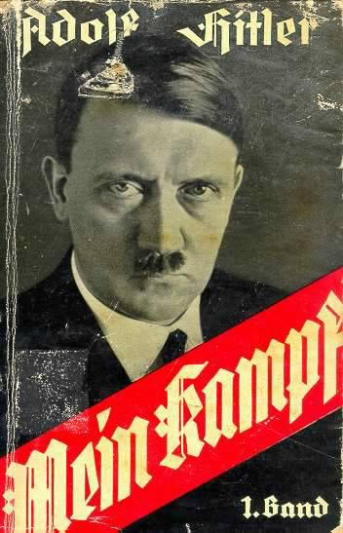
Rebuilding the Nazis
Hitler writes Mein Kampf (my struggle) while in jail.
It’s publication gains
national attention
The Nazis are banned and
Hitler prohibited from public speaking
NSDAP votes fall from
2milion in 1924 to
810,000 in 1928
Party membership continues to increase

Slide 6
Presidential Elections 1932
President Hindenburg’s 7 year term ended
Hitler campaigned hard, promising the public a solution to the hard times.
Hindenburg did not campaign at all
NSDAP Party membership at 450 000
Hitler organised 30 meetings per day and spoke in 21 cities in a single week
After the second round of voting Hindenburg achieved 53% of the vote, and at 83 years old, was re-elected

Slide 7

Hitler spoke in 50 cities in just 15 days
He was the first politician to use aircraft for campaigning

Slide 8
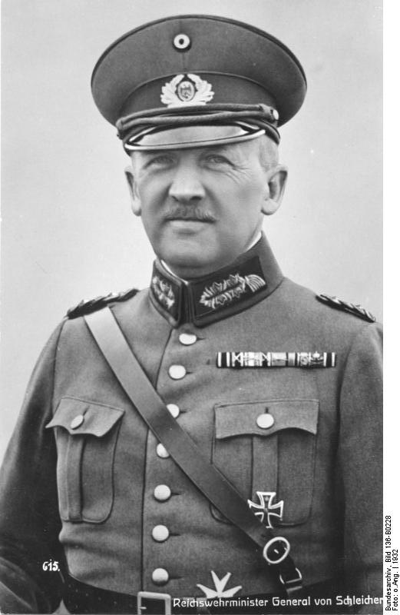
A new Chancellor
After the election, the SA and SS we banned
Brünning dismissed as Chancellor at the request of General Kurt von Schleicher
von Schleicher wanted to make
concessions with the Nazis
Franz von Pappen was appointed
as the new Chancellor
General Kurt von Schleicher

Slide 9
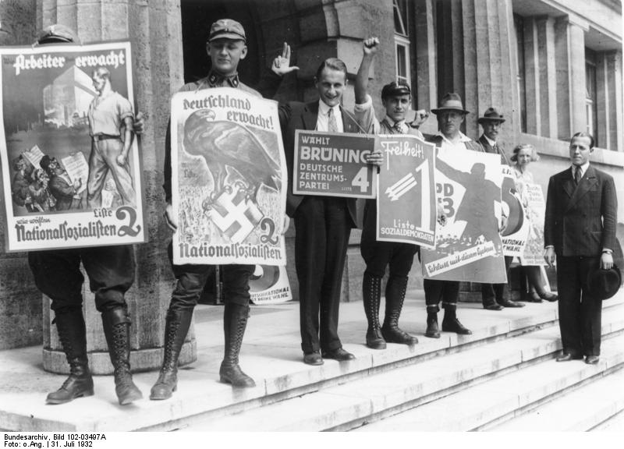
Reichstag Elections – July 1932
Hitler agreed to cooperate with the new government if the ban on the SA & SS was lifted.
The ban on the
was lifted, the
Reichstag was
dissolved and
new elections
held.

Slide 10
Election Results – July 1932

Slide 11
“A Queer Fellow”
After the July election Hitler demanded to be appointed as Chancellor, but Hindenburg refused referring to him as a “Queer fellow”
Schleicher organised an offer of Vice-Chancellor, but Hitler refused
The Reichstag carried a vote of no confidence again Pappen 512 to 42
Hindenburg dissolved parliament and Germans faced their 4th national election in 8 months

Slide 12
Reichstag Election – Nov. 1932
Nazis in financial trouble after intensive campaign for the July election
Nazis overall vote drops from 37.4% to 31%
Number of seats in Reichstag falls from 230 to 196
Communist support increases with seats rising from 89 to 100

Slide 13
Election Results – Nov. 1932

Slide 14
Aftermath of Nov. Election
Papen still lacking support from Reichstag
Hitler again demanded Chancellor
Hindenburg refused saying:
A Presidential Cabinet led by you would inevitably develop into a party dictatorship with all the consequences of drastic intensification of the antagonism within the German Nation
Privately Hindenburg commented to his State Secretary, Otto Meissner that he:
Couldn’t put a housepainter in Bismarck’s chair

Slide 15
The fall of von Papen
Papen believed that his lack of support from the Reichstag constituted a national emergency and appealed to Hindenburg to suspend the constitution’
Schleicher told Hindenburg that Germany faced civil war unless Papen was removed
Hindenburg asked Papen to resign and, in an attempt to keep Hitler out of power, made Schleicher the new Chancellor

Slide 16
The failure of von Schleicher
von Schleicher attempted to divide the Nazis by offering their Reichstag leader Gregor Strasser the Vice-Chancellor position
Hitler banned any deals be made with von Schleicher and ordered that all NSDAP swear an oath of loyalty to him personally
Papen offered role of Ambassador to France, but stayed in Berlin plotting von Schleicher’s demise

Slide 17
Hitler Becomes Chancellor
In January 1933 a series of secret meetings are held with Hitler, Papen, Oskar von Hindenburg and Otto Meissner
A proposal is put to President Hindenburg:
  Hitler be appointed Chancellor
  von Papen made Vice-Chancellor
  The Vice-Chancellor be present whenever the President and Chancellor meet
  Of 11 cabinet posts only 3 go to Nazis
  The remaining 8 cabinet positions to be held by Papen’s conservative supporters
Hitler is Chancellor

